Slide 1
Presentation to The College Board on SAT Participation Rates
Jerel Novick
June 14, 2019

Slide 2
Average Participation Rates
SAT
38.6% 2017
44.8% 2018
ACT
65.9% 2017
62.3% 2018

Slide 3
Participation Rate Distributions

Slide 4
SAT Top and Bottom Ten States
SAT Top Ten States
Michigan Connecticut
Delaware New Hampshire
Maine Idaho
Florida Massachusetts
Rhode Island New Jersey
SAT Bottom Ten States
North Dakota Mississippi
Iowa Missouri
Utah South Dakota
Nebraska Wisconsin
Wyoming Minnesota

Slide 5
ACT Top and Bottom Ten States
ACT Bottom Ten States
Maine Delaware
Rhode Island Pennsylvania
Michigan South Dakota
Nebraska Vermont
Massachusetts Michigan
ACT Top Ten States
Alabama Kentucky
Wisconsin Utah
Tennessee South Carolina
Oklahoma North Carolina
Nevada Ohio

Slide 6
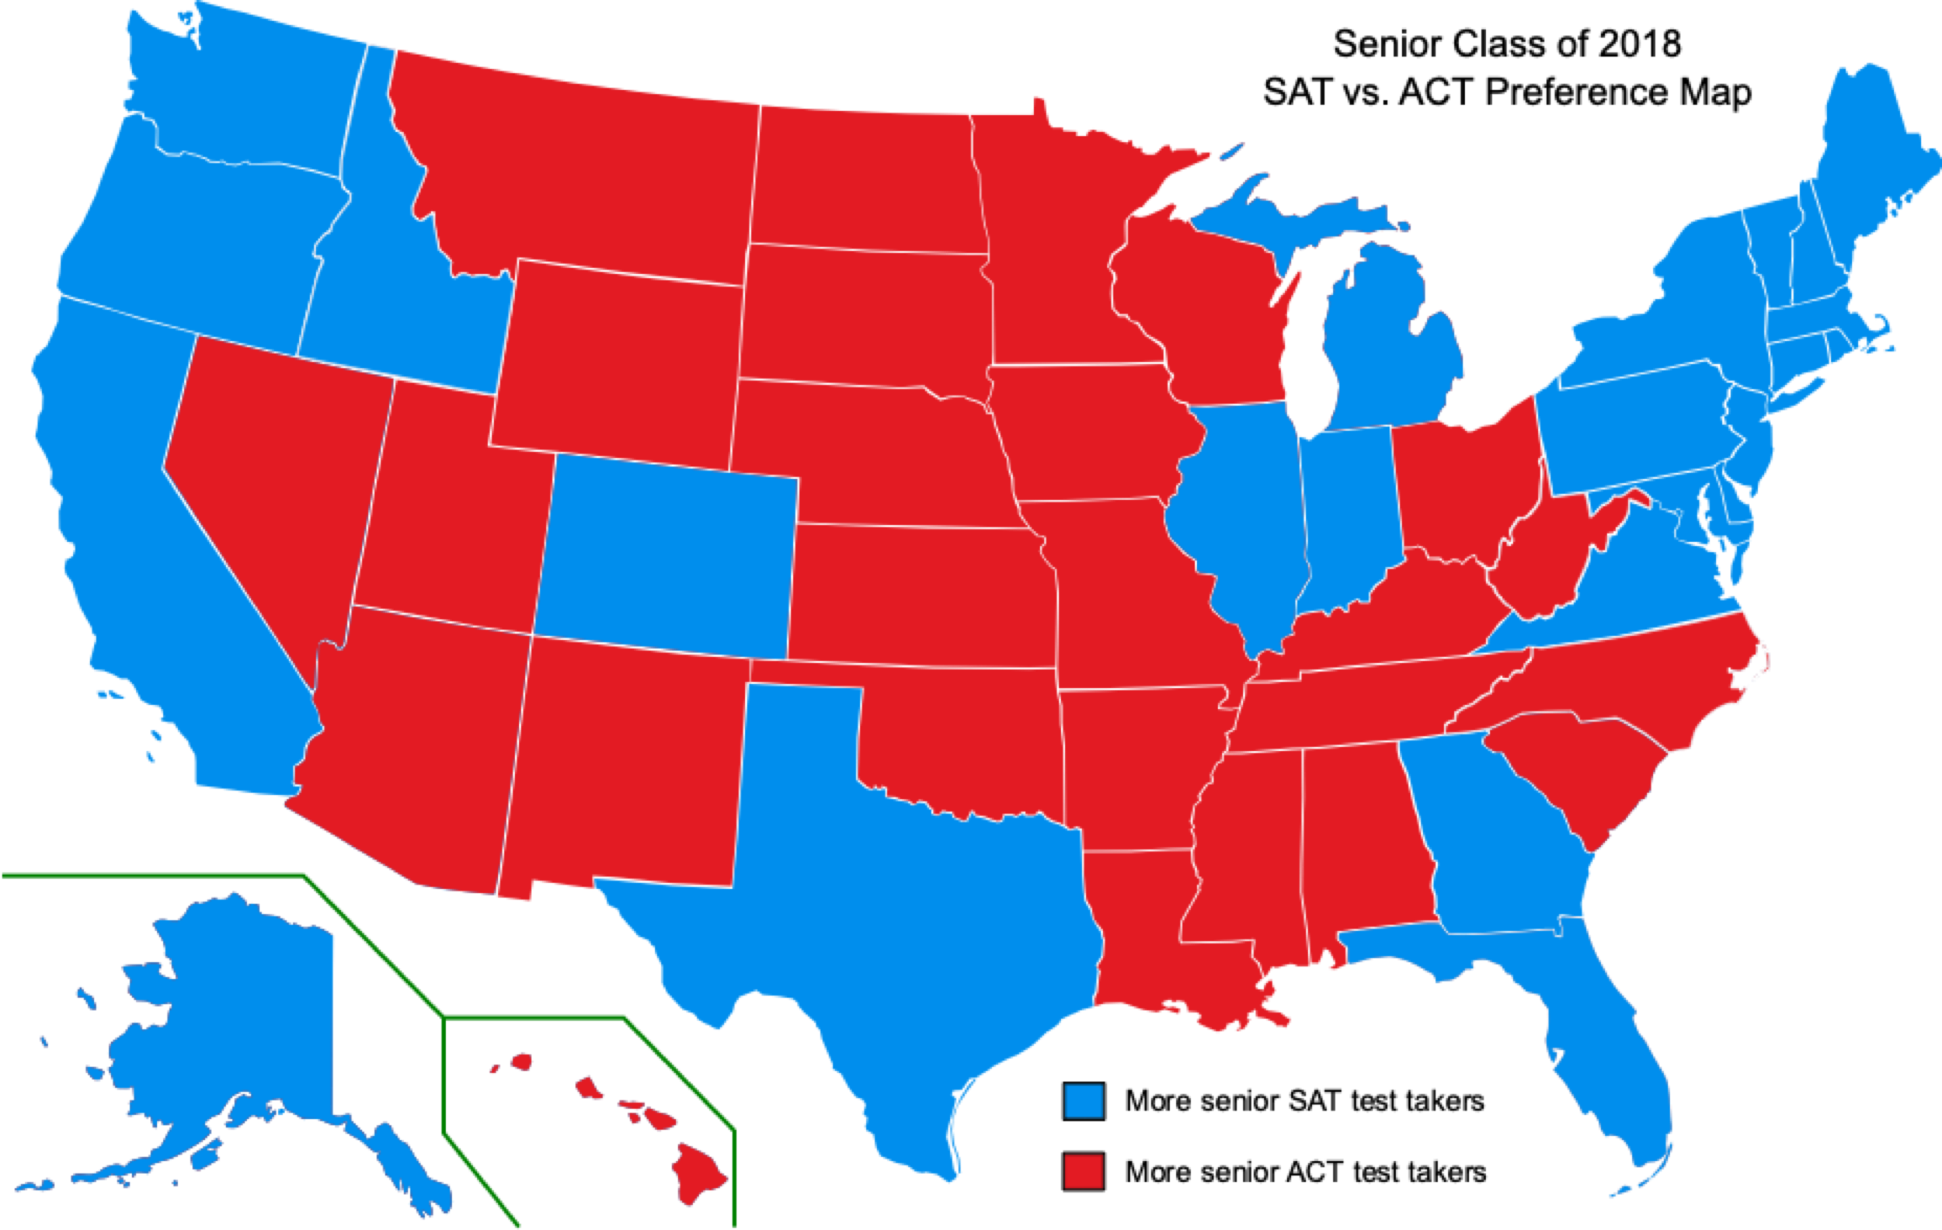
Geography
Source: Wikipedia

Slide 7
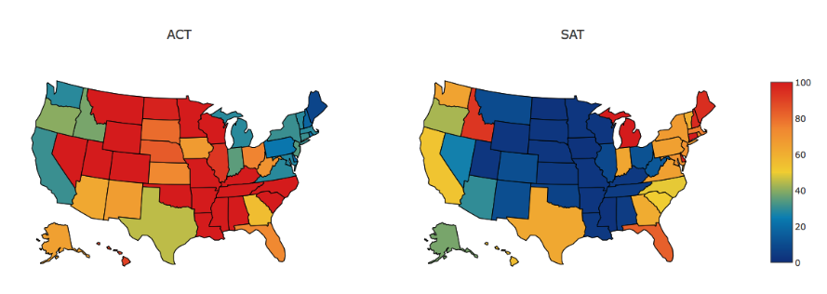
Geography
Source: Ken Lai

Slide 8
Population Not Participation
2.1 Million Students Took the SAT in 2018
1.9 Million Students Took ACT in 2018
First Time in 7 Years SAT Was Ahead of the ACT
Concentrate Efforts in Higher Population Green and Orange States Mainly The West Coast
Not Worth Battling Over Red/Blue State

Slide 9
Further Recommendations
Become Mandatory Test In More States
Colorado and Illinois Switched Over In 2018
Time Consuming Process
Compete on Price
SAT $47.50 ($64.50 With Optional Essay)
ACT $50.50 ($67 With Optional Writing Section)
Offer More SAT School Days
Test Given During The Week During School Hours
More Opportunities For Lower Income Students To Take The Test

Slide 10
Questions

